Slide 1
Chapter 13
How to work with recursion and algorithms

Slide 2
Objectives
Applied
Use recursion in a program.
Knowledge
Describe an algorithm.
Distinguish between the way the stack is used in a recursive function and the way it is used in an iterative function.
Distinguish between the base case for a recursive function and a deferred action.

Slide 3
An iterative function that loops infinitely
def display_message():
while True:
print("Press Ctrl+C to stop!")
The console
Press Ctrl+C to stop!
Press Ctrl+C to stop!
Press Ctrl+C to stop!
...
The stack after you interrupt the iterative function
display_message()

Slide 4
A recursive function that loops infinitely
def display_message():
print("Press Ctrl+C to stop!")
display_message()
The console
Press Ctrl+C to stop!
Press Ctrl+C to stop!
Press Ctrl+C to stop!
...
The stack after you interrupt the recursive function
display_message()
display_message()
display_message()
...

Slide 5
An iterative function
def add_numbers(upper):
total = 0
for number in range(upper + 1):
total += number
return total
A recursive function that does the same thing
def add_numbers(upper):
if upper == 0:
return upper
else:
return upper + add_numbers(upper - 1)

Slide 6
Code that calls the add_numbers() function
def main():
total = add_numbers(5) # total = 15
The function calls on the stack for the recursive function
main()
add_numbers() # puts add_numbers(4) on stack
upper = 5
add_numbers() # puts add_numbers(3) on stack
upper = 4
add_numbers() # puts add_numbers(2) on stack
upper = 3
add_numbers() # puts add_numbers(1) on stack
upper = 2
add_numbers() # puts add_numbers(0) on stack
upper = 1
add_numbers() # sums all values and returns the result
upper = 0

Slide 7
How to calculate the factorial of a number
0! = 1
1! = 1
2! = 2 * 1 = 2
3! = 3 * 2 * 1 = 6
4! = 4 * 3 * 2 * 1 = 24
5! = 5 * 4 * 3 * 2 * 1 = 120
An algorithm for calculating the factorial of a number
if n = 0 or n = 1, return 1
if n > 1, return n * (n-1)!

Slide 8
A recursive function that calculates the factorial of a number
def factorial(num):
if num == 0:
return 1
else:
return num * factorial(num - 1)
The function calls on the stack for the recursive function
factorial() # puts factorial(4) on stack
num = 5
factorial() # puts factorial(3) on stack
num = 4
factorial() # puts factorial(2) on stack
num = 3
factorial() # puts factorial(1) on stack
num = 2
factorial() # puts factorial(0) on stack
num = 1
factorial() # performs calculation and returns result
num = 0

Slide 9
An iterative function that calculates the factorial of a number
def factorial(num):
fact = 1
for number in range(2, num+1):
fact = number * fact
return fact

Slide 10
The Fibonacci series
0, 1, 1, 2, 3, 5, 8, 13, 21, 34, 55, 89, 144, 233, 377, 610, ...
A recursive function that calculates a Fibonacci series
def fib(n):
if n == 0:
return 0
elif n == 1:
return 1
else:
return fib(n - 1) + fib(n - 2)
A statement that prints the first 10 numbers of the Fibonacci series
for i in range(10):
print(fib(i), end=", ")

Slide 11
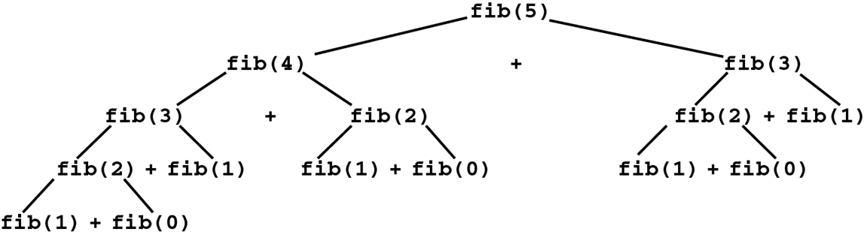
The tree of function calls that calculate the 5th number in the series

Slide 12
An iterative function that computes a Fibonacci sequence
def fib(n):
if n == 0:
return 0
elif n == 1:
return 1
n1 = 0
n2 = 1
fib = 0
for i in range(2, n+1):
fib = n1 + n2
n1 = n2
n2 = fib
return fib

Slide 13
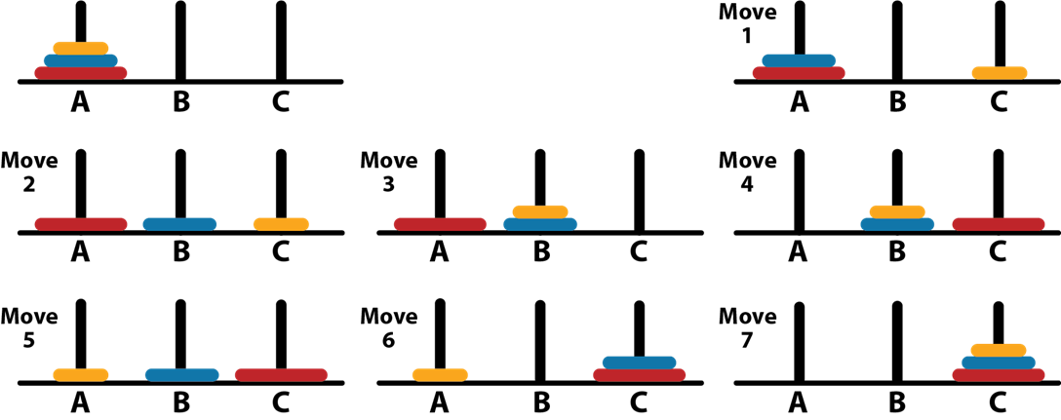
How to solve the Towers of Hanoi puzzle with 3 disks

Slide 14
The rules for the Towers of Hanoi puzzle
The goal is to move all disks from peg A to peg C so they end up in the same order as on the original peg.
You can only move one disk at a time.
You must move the disk to one of the three pegs.
You can’t place a larger disk on top of a smaller disk.

Slide 15
A recursive algorithm for solving the puzzle
Move n-1 disks from peg A to peg B using peg C as a temporary holder.
Move disk n from peg A to peg C.
Move n-1 disks from peg B to peg C using peg A as a temporary holder.
A function that implements the recursive algorithm
def move_disk(n, src, dest, temp):
if n == 0:
return
else:
move_disk(n-1, src, temp, dest)
print("Move disk", n, "from", src, "to", dest)
move_disk(n-1, temp, dest, src)

Slide 16
The user interface for the Towers of Hanoi puzzle
**** TOWERS OF HANOI ****
Enter number of disks: 4
Move disk 1 from A to B
Move disk 2 from A to C
Move disk 1 from B to C
Move disk 3 from A to B
Move disk 1 from C to A
Move disk 2 from C to B
Move disk 1 from A to B
Move disk 4 from A to C
Move disk 1 from B to C
Move disk 2 from B to A
Move disk 1 from C to A
Move disk 3 from B to C
Move disk 1 from A to B
Move disk 2 from A to C
Move disk 1 from B to C
All disks have been moved.

Slide 17
The code for solving the Towers of Hanoi puzzle
def move_disk(n, src, dest, temp):
if n == 0:
return
else:
move_disk(n-1, src, temp, dest)
print(f"Move disk {n} from {src} to {dest}")
move_disk(n-1, temp, dest, src)
def main():
print("**** TOWERS OF HANOI ****")
print()
num_disks = int(input("Enter number of disks: "))
print()
move_disk(num_disks, "A", "C", "B")
print()
print("All disks have been moved.")
if __name__ == "__main__":
main()

Slide 18
The pattern for 4 disks (15 moves)
1 2 1 3 1 2 1 4 1 2 1 3 1 2 1
The pattern for 5 disks (31 moves)
1 2 1 3 1 2 1 4 1 2 1 3 1 2 1 5 1 2 1 3 1 2 1 4 1 2 1 3 1 2 1

